Slide 1
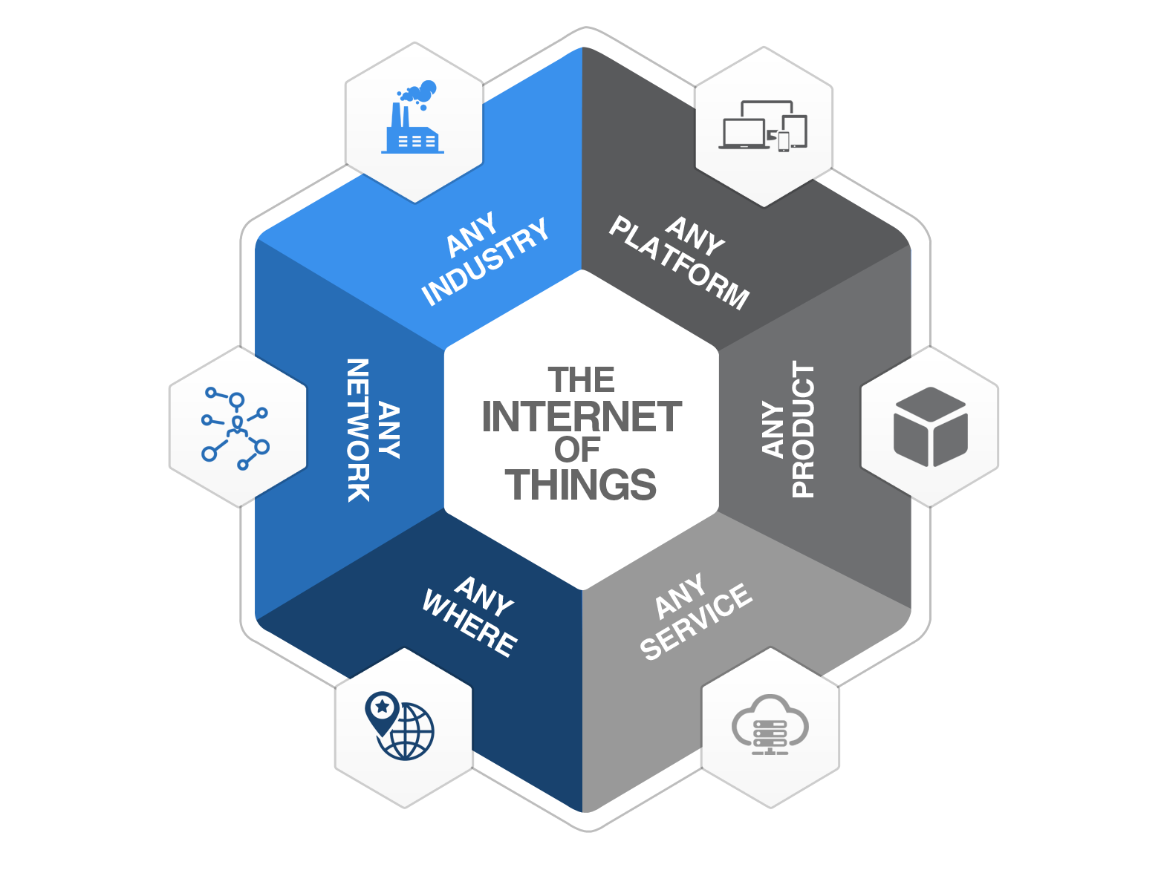

Module 3
CLOUD AND DATA ANALYTICS FOR IOT
Cloud: Types of Cloud - loT with Cloud challenges - Selection of cloud for loT applications - Fog and Edge computing for loT - Cloud security aspects for loT applications. Data Analytics for IoT: Overview of Hadoop ecosystem – MapReduce architecture – MapReduce Job Execution – MapReduce Schedulers. Case study: Internet of Medical Things (IoMT)
Watch this video: Click Here
Module 3

Slide 2
Introduction to Edge and Fog Computing
Edge Computing: A distributed computing paradigm that processes data at the source (edge) instead of relying on a central cloud.
Fog Computing: Extends cloud computing closer to the network edge, offering additional computing and storage.
Importance in IoT: Enables real-time data processing, reduces latency, and improves efficiency.

Slide 3
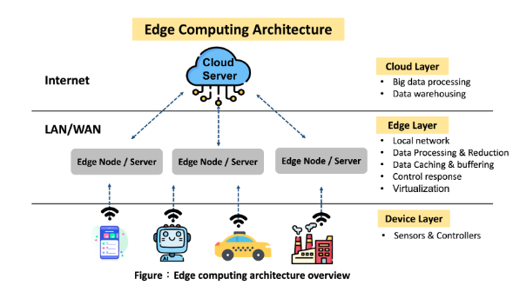
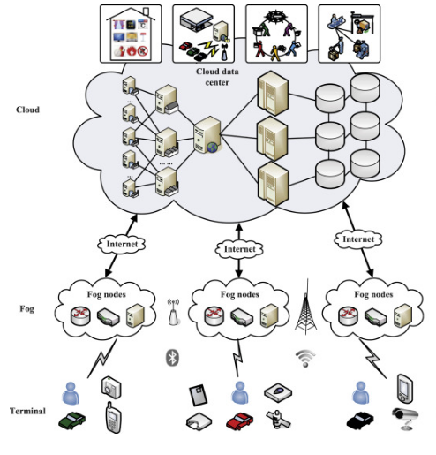
Introduction to Edge and Fog Computing

Slide 4
Need for Edge Computing in IoT
IoT devices generate vast amounts of data.
Traditional cloud computing introduces high latency.
Edge computing enables faster data processing and decision making.
Reduces bandwidth costs by processing data locally.

Slide 5
How Edge Computing Works
IoT devices collect data.
Data is processed locally on edge devices (e.g., routers, gateways, or microcontrollers).
Processed insights are sent to the cloud only when necessary.
Enables real-time decision-making without cloud dependency.

Slide 6
Advantages of Edge Computing in IoT
Reduced Latency: Faster response times for critical applications.
Bandwidth Optimization: Less data sent to the cloud reduces congestion.
Enhanced Security: Local data processing minimizes security risks.
Reliability: Operates even with limited or no cloud connectivity.
Energy Efficiency: Reduces power consumption by minimizing cloud interactions

Slide 7
Comparison - Edge vs. Fog vs. Cloud Computing
Feature | Edge Computing | Fog Computing | Cloud Computing
Processing Location | Device-level | Network-level | Remote Data Centers
Latency | Low | Medium | High
Bandwidth Usage | Low | Medium | High
Security | High | Medium | Low
Real-time Processing | Yes | Yes | No

Slide 8
Real-World Applications of Edge Computing
Smart Cities: Traffic management, surveillance, and environmental monitoring.
Healthcare: Remote patient monitoring and real-time diagnostics.
Industrial IoT (IIoT): Predictive maintenance in factories.
Autonomous Vehicles: Real-time data processing for navigation.
Retail: Personalized shopping experiences and inventory management.

Slide 9
Challenges and Future Trends
Challenges:
Security risks due to distributed nature.
Managing a large number of edge devices.
Higher initial infrastructure costs.
Future Trends:
AI-driven edge computing for smarter decision-making.
5G integration for enhanced connectivity.
Growth of edge data centers.

Slide 10
Role of Edge Computing in IoT
Real-Time Processing: Enables immediate response to IoT data without relying on cloud latency.
Decentralized Data Handling: Reduces dependency on centralized cloud infrastructure, improving efficiency.
Bandwidth Reduction: Filters and processes critical data at the edge, reducing unnecessary cloud communication.
Enhanced Security & Privacy: Data remains closer to the source, reducing risks associated with cloud storage.
Improved Reliability: Works even with limited or no internet connectivity, ensuring continuous IoT operations

Slide 11
Comparison Between Edge Computing and Cloud Computing
Edge Computing and Cloud Computing are two paradigms that handle data processing differently. While Cloud Computing relies on centralized data centers, Edge Computing processes data closer to the source.
Below is a detailed comparison:
1. Processing Location
Edge Computing: Data is processed at the edge of the network, such as IoT devices, local servers, or gateways.

Slide 12
Comparison Between Edge Computing and Cloud Computing
Cloud Computing: Data is processed in centralized cloud data centers located far from the source.
2. Latency
Edge Computing: Provides low latency as data is processed near the source, making it suitable for real-time applications.
Cloud Computing: Higher latency due to data transmission to remote servers, causing delays in time-sensitive applications.
3. Bandwidth Usage
Edge Computing: Reduces bandwidth consumption by processing data locally, sending only relevant insights to the cloud.
Cloud Computing: Consumes more bandwidth as all raw data is transferred to centralized servers for processing.

Slide 13
Comparison Between Edge Computing and Cloud Computing
Security & Privacy
Edge Computing: More secure as sensitive data is processed locally, reducing risks associated with data transmission.
Cloud Computing: Security risks are higher due to centralized data storage and potential exposure during transmission.
5. Reliability & Availability
Edge Computing: Works even with limited or no internet connectivity, making it more reliable in remote areas.
Cloud Computing: Requires continuous internet connectivity for real-time access and data processing.

Slide 14
Comparison Between Edge Computing and Cloud Computing
6. Scalability
Edge Computing: Scalability is limited by local hardware constraints, making it more difficult to scale compared to the cloud.
Cloud Computing: Easily scalable with flexible storage and processing power in large-scale data centers.
7. Cost Efficiency
Edge Computing: Reduces operational costs by lowering bandwidth usage and cloud dependency but may have higher hardware costs.
Cloud Computing: Lower hardware costs but higher operational costs for data transmission and storage.

Slide 15
Comparison Between Edge Computing and Cloud Computing
8. Real-Time Decision Making
Edge Computing: Supports real-time processing, making it ideal for applications like autonomous vehicles, smart grids, and healthcare monitoring.
Cloud Computing: Slower response time due to network dependency, which is unsuitable for time-sensitive applications.
9. Use Cases
Edge Computing: Suitable for Autonomous Vehicles, Industrial IoT (IIoT), Smart Cities, Remote Healthcare, and Security Surveillance.
Cloud Computing: Used for Big Data Analysis, AI Model Training, Centralized Data Storage, and Enterprise Applications.

Slide 16
Comparison Between Edge Computing and Cloud Computing
10.Energy Consumption
Edge Computing: More energy-efficient as it processes data locally, reducing the need for data transfer.
Cloud Computing: Requires large-scale data centers, which consume significant energy for storage and computing.

Slide 17

3.7 IOT Security for IoT Application

Slide 18
Thank You

